Slide 1
Permanent Magnet
Synchronous Motor
Presenters: 陈若旭 张博文 黄俣升 药育帆

Slide 2
CONTENTS
1
2
3
4
The Main Structure
The Equivalent Circuit
Advantages
And Disadvantages
Application Fields

Slide 3
1
The Main Structure

Slide 4
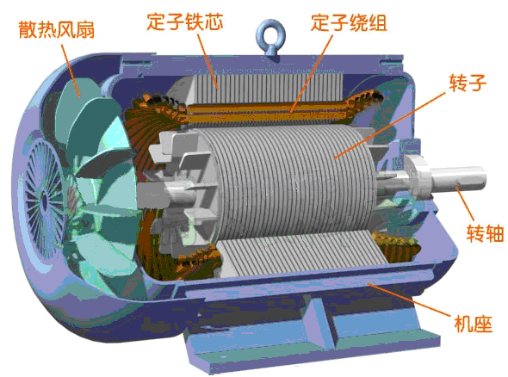
BASIC STRUCTURE
Stationary Stator
（Armature Winding）
Rotating Rotor
（Permanent Magnets）
Cooling fan
Other Components
Motor Base
...

Slide 5
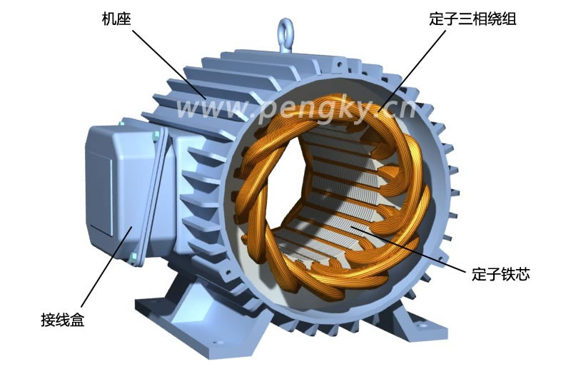
Stationary Stator（Armature Winding）
·Can be concentrated or distributed
·Can be short-pitched or full-pitched,
short-pitched in more case
·Similar with the armature winding in excitation synchronous motor

Slide 6
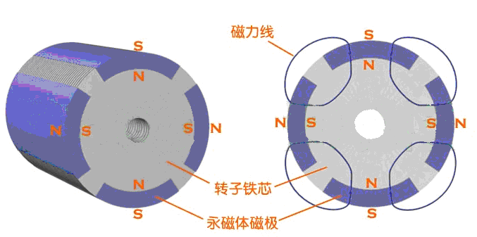
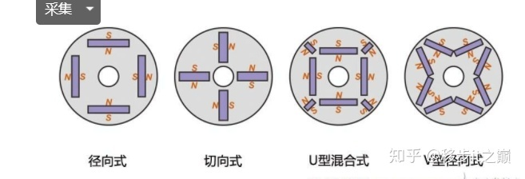
Rotating Rotor（Permanent Magnets
Radial
（径向式）
Tangential
（切向式）
U-Hybrid
（U型混合式）
V-Hybrid
（V型混合式）
Surface Mounted
（突出式）
Interior/Buried
（内置式）

Slide 7
Rotating Rotor（Permanent Magnets）
Surface Mounted PMSM – the magnet is placed on the surface of the rotor.
·As the magnet and air permeability are similar, this kind of design creates a regular air gap. So, there is no presence of reluctant torque.
·The dynamic efficiency of the motor is more and so it is applicable for high performed machine tool drivers and the robotics domain.
·As the design of this kind is not robust, it is not applicable for applications those function at high speed.
Interior/Buried PMSM – the permanent magnets are placed inside the rotor other than placing on the rotor’s surface.
·This enhances device strength and so used for applications that operate at high speed.
·As because of the salience feature, there exists reluctant torque in the PMSM.

Slide 8
2
The Equivalent Circuit

Slide 9
Assumptions:
The stator winding is Y-type connection, the three-phase winding is symmetrical distribution, and the axis difference is 120°;
Both permanent magnet field and armature field are sinusoidal in the air gap.
In steady state operation, the induced electromotive force waveform in the phase winding is sinusoidal wave;
Ignoring core saturation effect, ignoring eddy current and hysteresis loss;
The working condition of the electrical equipment is not affected by temperature and frequency.
Notes:
In the previous part, the basic structure of a permanent magnet synchronous motor is introduced. And then I will introduce its equivalent circuit. Before summarizing the equivalent circuit and phasor diagram of the permanent magnet synchronous motor, it is necessary to state that all of these must be based on some idealized assumptions, including

Slide 10
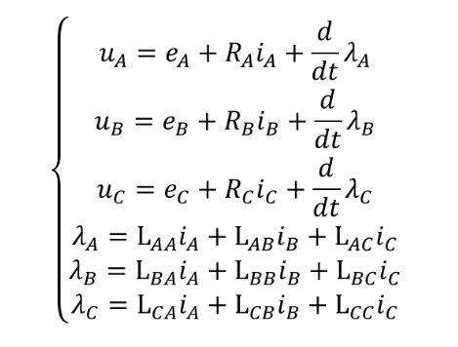
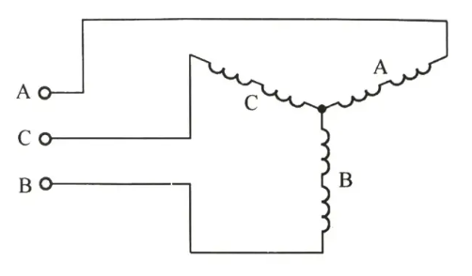
Inductance model of motor
circuit model
circuit equation
Notes:
First, let's introduce the inductance model of the motor. From the point of view of the power supply, the permanent magnet synchronous motor can be regarded as a three-phase circuit with three coils (winding); And the ends of the three coils are connected in parallel. There are three types of physical effects on each coil:
The first one is No-load back electromotive force : which; means When the permanent magnet rotates with the rotor, an induced voltage is generated in the coil; It refers to eA;
The second one is Resistance effect, in other words, When a current is passed through the winding, a resistive voltage drop in phase with the current is generated;
The last one is Reactance effect or inductance effect, It is used to represent the inductive voltage drop produced by the winding after AC current is applied
In the picture on the right, I have listed its circuit equation:$U_{A}$ Is the phase voltage of coil A; $E_{A}$ Is the induced electromotive force of coil A;
$R_{A}$ Is the resistance of coil A;
$λ_{A}$ Is the flux of coil A
L_aa is the self-inductance, and Lab Lac is the mutual-inductance.

Slide 11

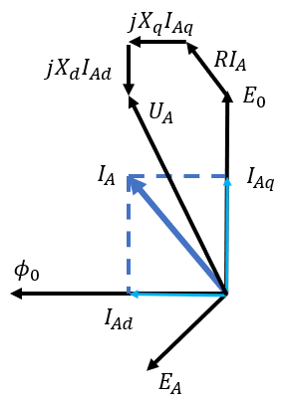
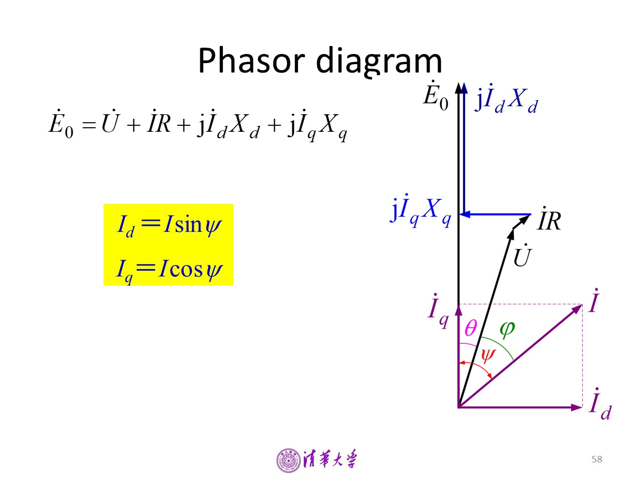
Phasor diagrams
excitation synchronous motor working in generator condition
PMSM working in motor condition(phase A)
Notes:
Next let's look at the phasor diagram of the permanent magnet synchronous motor.
the left is the excitation synchronous motor working in generator condition, the right is permanent magnet synchronous motor working in motor condition(it is just phase A)
We can compare these two phasor diagrams, and see that it is very similar
This is the relationship between U and E.
We know for the non-salient pole motor, Xd equal to Xq equal to Xs,
So we can simplify this relationship , and because Iad plus Iaq equal to IA,this relationship is simple.

Slide 12
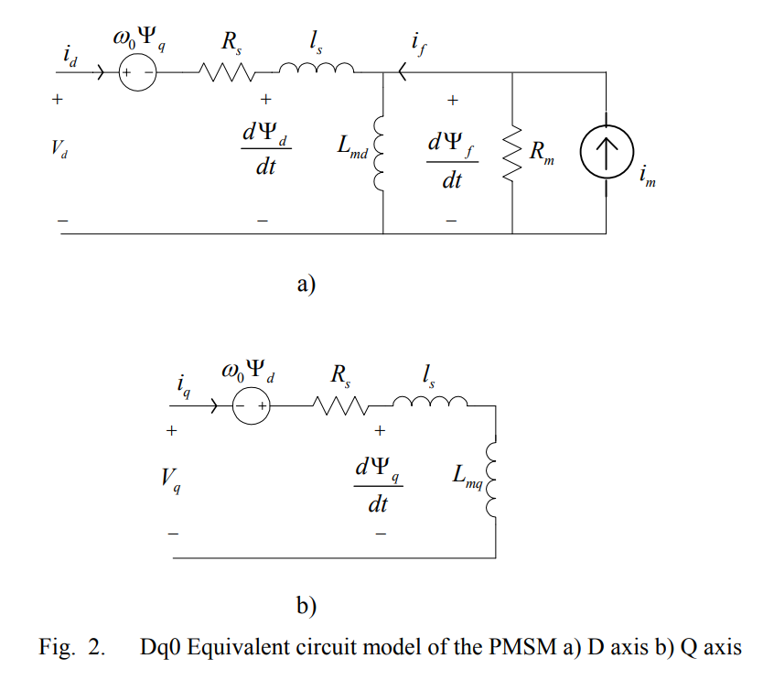
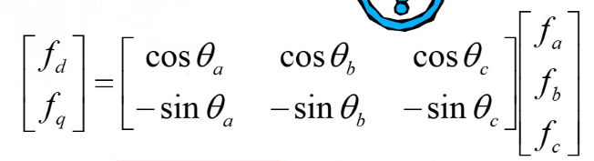
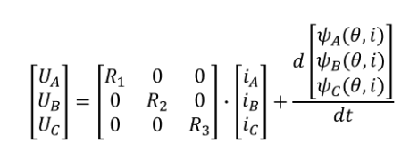
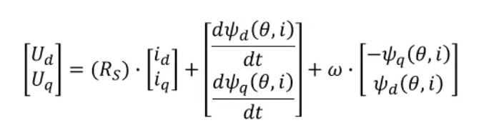
Equivalent circuit in DQ coordinate system
Notes:
Then we see something different from the DQ coordinate system.
This is the Park transformation that we have talked about earlier.
First we should know the principle of park transformation.
We convert the coordinate system of a, b and c to the coordinate system of d, q and 0 by the following relations,
which is equivalent to observing on the rotor to simplify the inductance which is changing.
Here the D and Q axes correspond to the direct and intersection axes in the previous phasor diagram
Forgive me for using a screenshot from the Power systems course.
On the left are the equivalent circuits of the D and Q axes after the Park transformation
On the right is the corresponding equation from a,b,c to d,q
The model is similar to the conventional equivalent circuit of the synchronous machine, except there is no leakage inductance on the field.
This is my part of the introduction, next let's welcome Zhang Bowen to introduce the advantages and disadvantages of the motor for us

Slide 13
3
Advantages And Disadvantages

Slide 14
Advantages
ADVANTAGES
0
02
High Efficiency High
Power Density
High Starting Torque
03
04

Slide 15
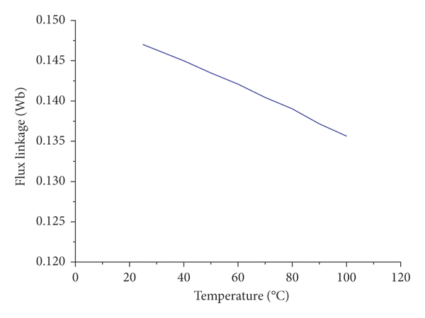
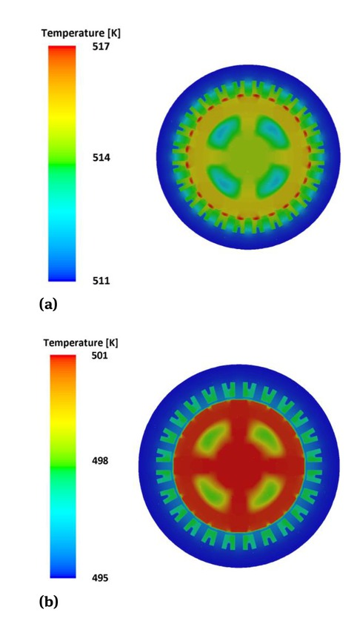
DISADVANTAGES
DISADVANTAGES
the relationship between the rotor flux linkage and its temperature.
expensive
strict requirement on operating temperature
fixed magnetic field

Slide 16
4
Application Fields

Slide 17
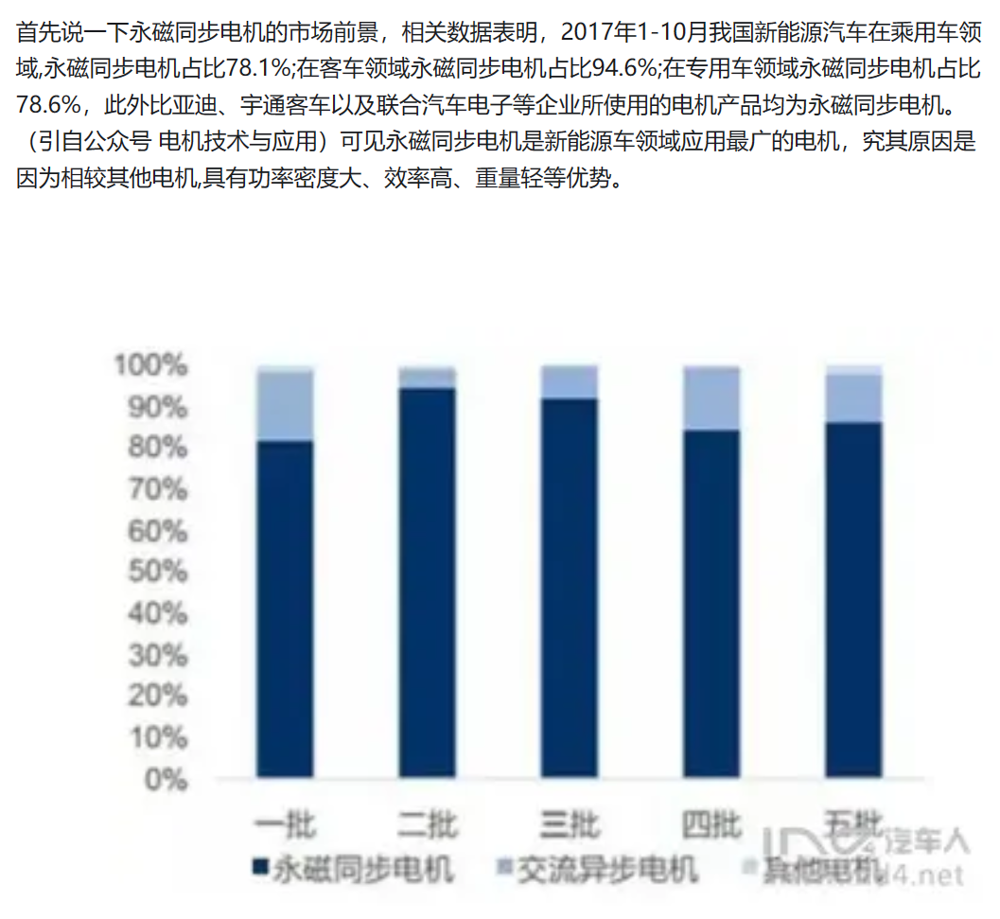

Electric Vehicles (Evs))

Slide 18
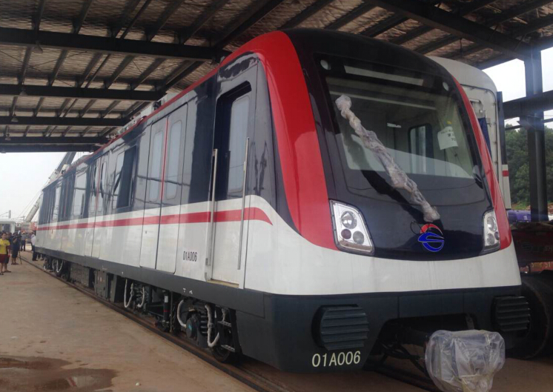
Rail Transportation
Changsha Metro Line 1

Slide 19
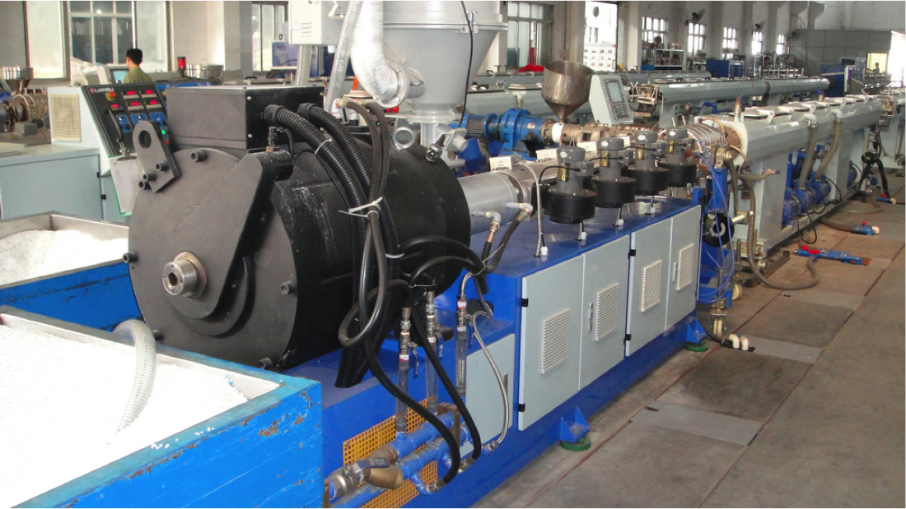
Industrial Automation

Slide 20
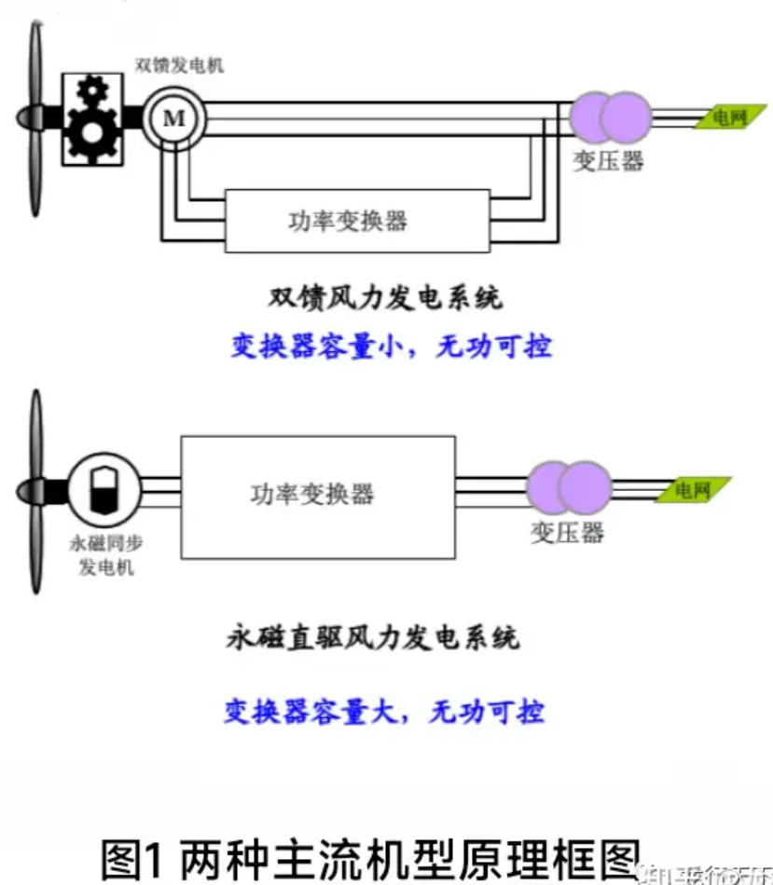

Renewable Energy Applications

Slide 21
THANKS FOR LISTENING
Notes:
更多精品素材：http://shop248912786.taobao.com/index.htm （下拉可隐藏）

